Slide 1
Lecture 5 The Market Forces of Supply and Demand

Slide 2
The Market Forces of Supply and Demand
The Theory of Supply and Demand
Supply and demand are the two words that economists use most often— they are the forces that make market economies work.
They determine the quantity of each good produced and the price at which it is sold.
If you want to know how any event or policy will affect the economy, you must think first about how it will affect supply and demand.

Slide 3
The Market Forces of Supply and Demand
Markets and Competition
The terms supply and demand refer to the behavior of people as they interact with one another in competitive markets.
Before discussing how buyers and sellers behave, let’s first consider more fully what we mean by the terms market and competition.
A market is a group of buyers and sellers of a particular good or service. The buyers as a group determine the demand for the product, and the sellers as a group determine the supply of the product.

Slide 4
The Market Forces of Supply and Demand
Markets and Competition
Markets take many forms. Sometimes markets are highly organized and more often they are less organized.
A competitive market is a market in which there are many buyers and many sellers so that each has a negligible impact on the market price.
In this chapter, we assume that markets are perfectly competitive. A competitive market must have two characteristics: (1) the goods are identical, and (2) the buyers and sellers are so numerous that no single buyer or seller has any influence over the market price.

Slide 5
The Market Forces of Supply and Demand
Demand
The quantity demanded of any good is the amount of the good that buyers are willing and able to purchase.
Demand is the representation of the various amounts of a product that consumers are willing and able to purchase at each of a series of possible prices during a specific period of time.
To be a demand for a commodity, you should
want it
afford it
plan to buy it

Slide 6
The Market Forces of Supply and Demand
Law of Demand
The law of demand states that other things being equal, when the price of a good rises, the quantity demanded of the good falls, and when the price falls, the quantity demanded rises.
When the price of a commodity is raised, other things remain constant, buyer tend to buy less of the commodity and vice versa.

Slide 7
The Market Forces of Supply and Demand
Demand Schedule and Demand Curve
Demand Schedule:
A demand schedule is a list showing the quantity of a good that consumers would choose to purchase at different prices, with all other things held constant.
Demand Curve:
A demand curve graphically shows the relationship between the price of a good and the quantity demanded (demand schedule), holding constant all other variables that influence demand.

Slide 8
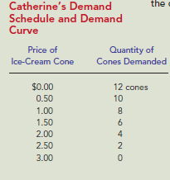
The Market Forces of Supply and Demand
Demand Schedule
Demand Schedule is a table that shows the relationship between the price of a good and the quantity demanded of that good.

Slide 9
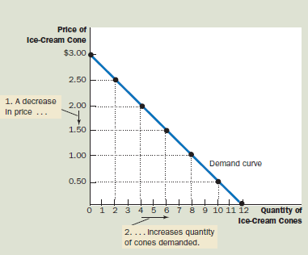
The Market Forces of Supply and Demand
Demand Curve
Demand curve is a graph that shows the relationship between the price of a good and the quantity demanded

Slide 10
The Market Forces of Supply and Demand
Why Does Quantity Demanded Go Down as Price Goes Up?
The law of demand states that price and quantity demanded are inversely related. Quantity demanded goes down as prices goes up due to
People substitute lower priced goods for higher priced goods.
Law of diminishing marginal utility

Slide 11
The Market Forces of Supply and Demand
Market Demand versus Individual Demand
The demand curve in Figure 1 shows an individual’s demand for a product.
To analyze how markets work, we need to determine the market demand, the sum of all the individual demands for a particular good or service.
The table in Figure 2 shows the demand schedules for ice cream of the two individuals in this market—Catherine and Nicholas. The market demand at each price is the sum of the two individual demands.

Slide 12
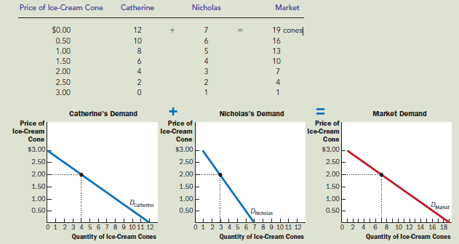
The Market Forces of Supply and Demand
Market Demand versus Individual Demand

Slide 13
The Market Forces of Supply and Demand
Market Demand versus Individual Demand
Notice that in Figure 2, we sum the individual demand curves horizontally to obtain the market demand curve.
Because we are interested in analyzing how markets function, we work most often with the market demand curve.
The market demand curve shows how the total quantity demanded of a good varies as the price of the good varies, while all the other factors that affect how much consumers want to buy are held constant.

Slide 14
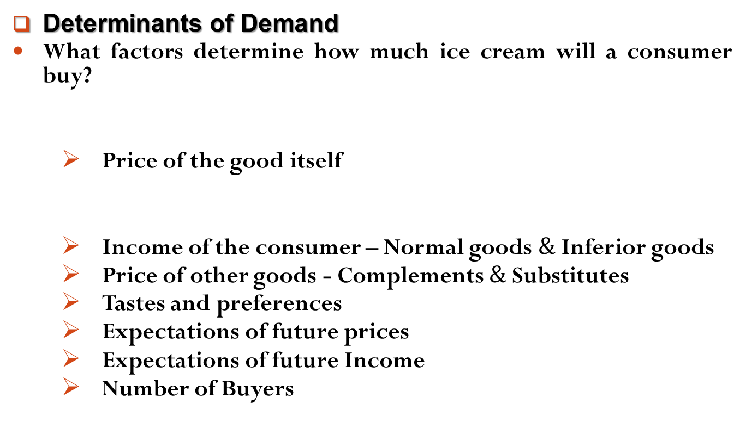
The Market Forces of Supply and Demand
Determinants of Demand
What factors determine how much ice cream will a consumer buy?
Price of the good itself
Income of the consumer – Normal goods $\&$ Inferior goods
Price of other goods - Complements $\&$Substitutes
Tastes and preferences
Expectations of future prices
Expectations of future Income
Number of Buyers
Movement Factor
Shift Factors

Slide 15
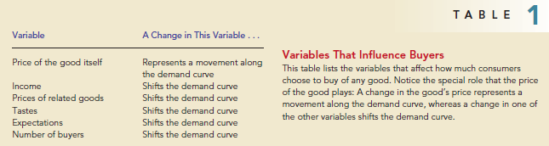
The Market Forces of Supply and Demand
Determinants of Demand
Table 1 lists the variables that influence how much consumers choose to buy of a good.

Slide 16
The Market Forces of Supply and Demand
Movement Along the Demand Curve or A change in Quantity Demanded
A change in quantity demanded is however reflected in a movement along the demand curve and is called an extension or a contraction in quantity demand.
The movement along the demand curve is due to the change in price of the good while all other factors remaining unchanged.

Slide 17
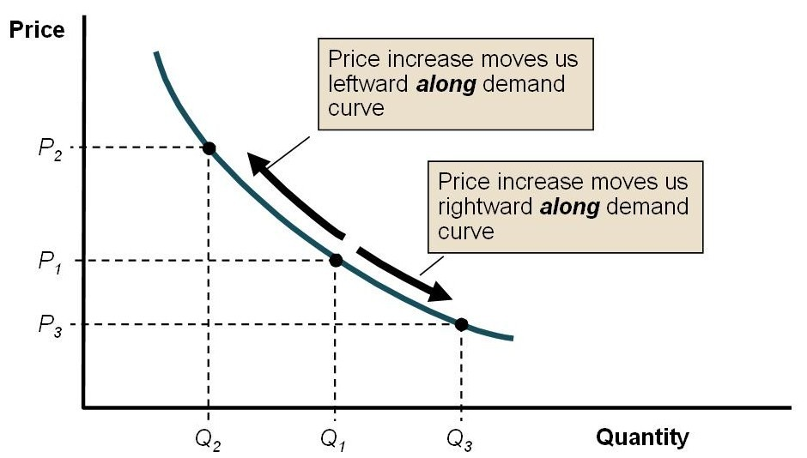
The Market Forces of Supply and Demand
Movement Along the Demand Curve or A change in Quantity Demand

Slide 18
The Market Forces of Supply and Demand
Shift of the Demand Curve or Change in Demand
A change in demand is reflected by shift of the demand curve and is called an rise or a fall in demand.
The shift of the demand curve is caused by a change in any of the non-price determinants (Income, Price of other goods, Tastes and preferences, Expectations, Number of Buyers etc.) of demand.

Slide 19
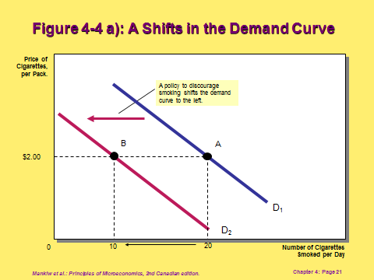
The Market Forces of Supply and Demand
Shift of the Demand Curve or Change in Demand

Slide 20
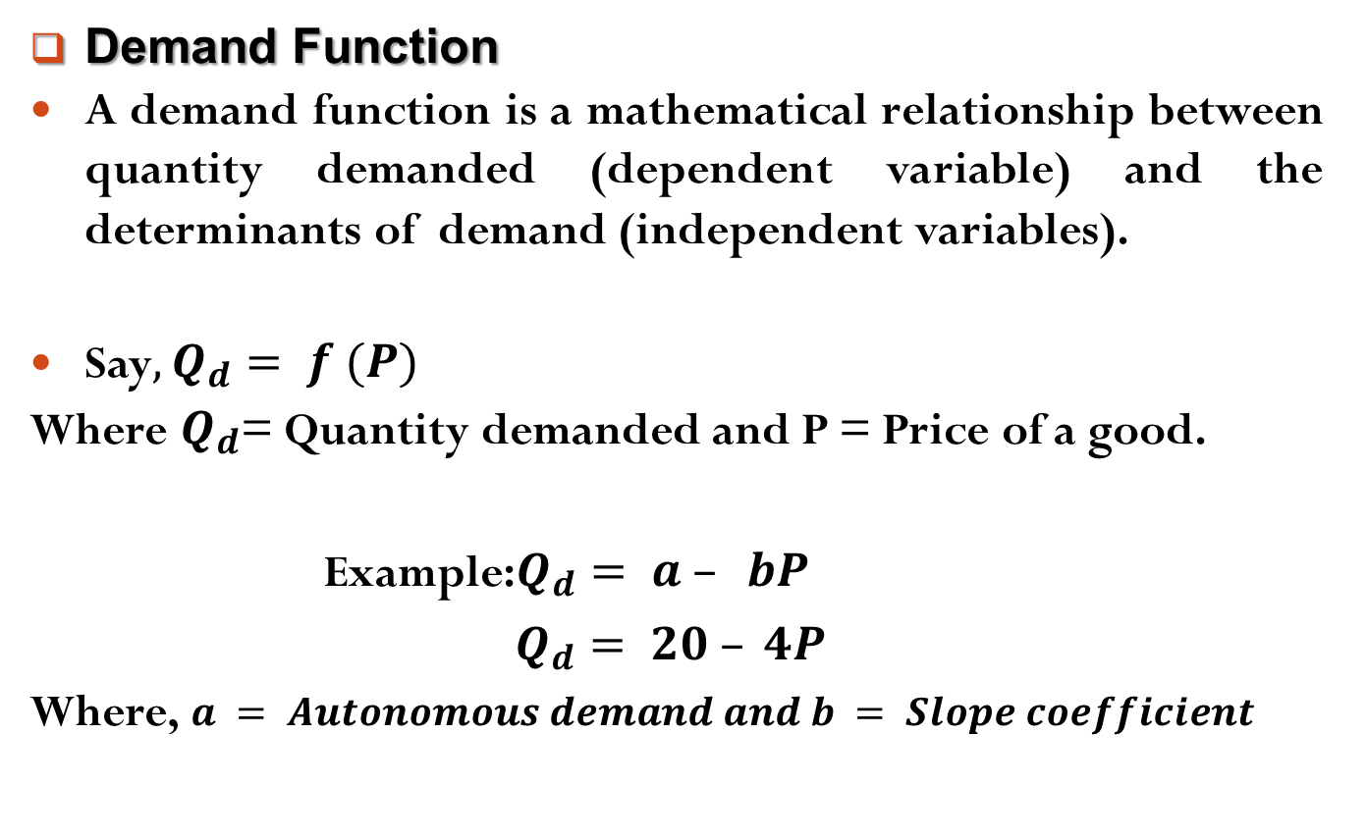
The Market Forces of Supply and Demand
Demand Function
A demand function is a mathematical relationship between quantity demanded (dependent variable) and the determinants of demand (independent variables).
Say$,Q_{d}= f (P)$
Where $Q_{d}$= Quantity demanded and P = Price of a good.
Example:$Q_{d}= a – bP$
$Q_{d}= 20 – 4P$
Where, $a = Autonomous demand and b = Slope coefficient$

Slide 21

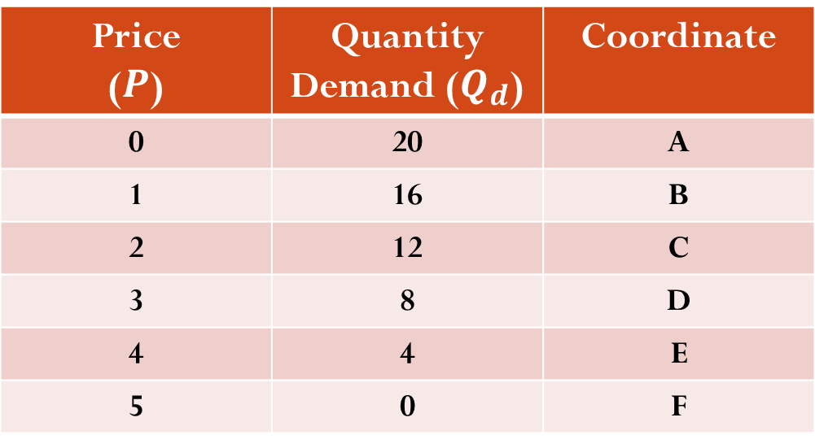
The Market Forces of Supply and Demand
Demand Function
Example: $Q_{d}=20 – 4P$
Demand Schedule from a Demand Function
Price ($P$) | Quantity Demand ($Q_{d}$) | Coordinate
0 | 20 | A
1 | 16 | B
2 | 12 | C
3 | 8 | D
4 | 4 | E
5 | 0 | F

Slide 22

The Market Forces of Supply and Demand
Demand Function
Example: $Q_{d}=20 – 4P$
Demand Curve from a Demand Function
Price
F
5
4
3
2
1
0
E
D
C
B
A
4 8 12 16 20
Quantity Demanded

Slide 23
Readings
N. G. Mankiw- Principles of Microeconomics, 5th Edition, Chapter – 4.
Roger A. Arnold- Microeconomics, 10th Edition, Chapter – 3.

Slide 24


Slide 25
Thank You

